Slide 1

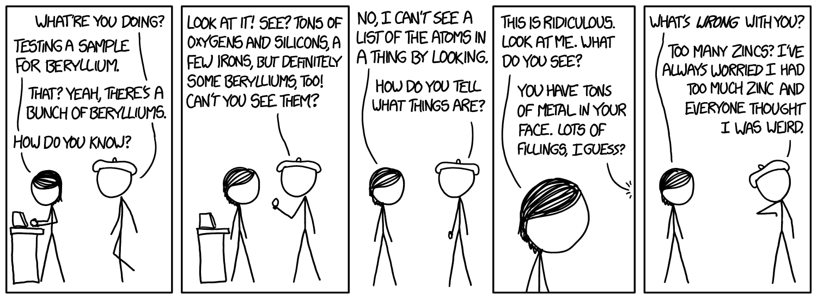
xkcDaily
A comical daily calendar

Slide 2
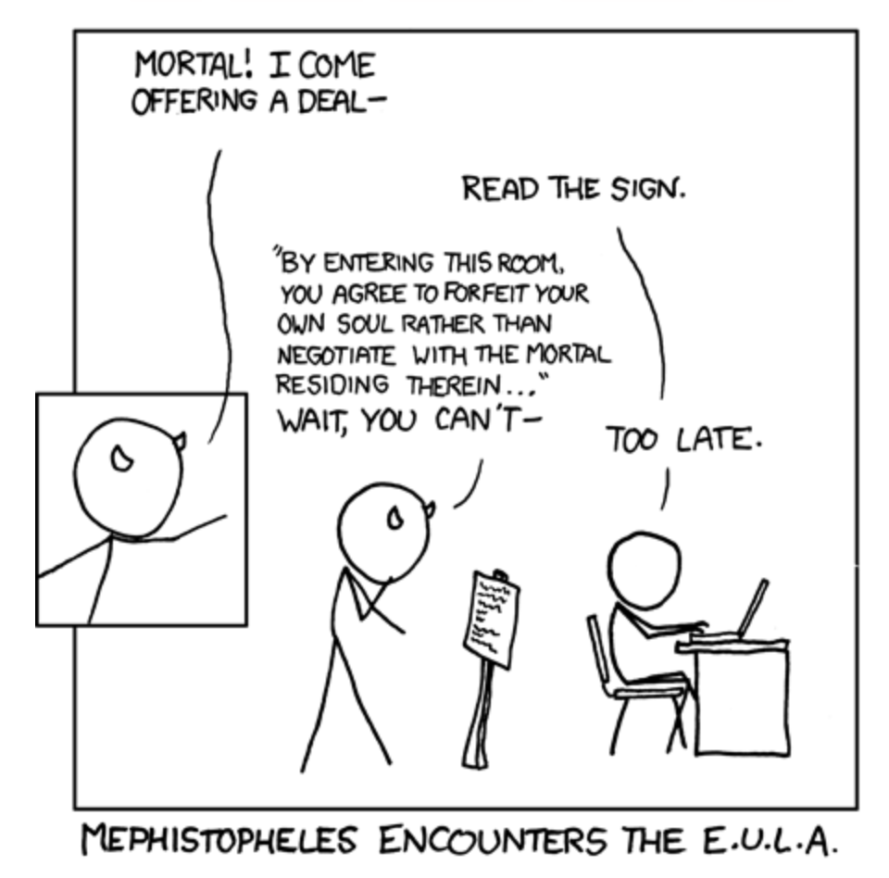
Need more xkcd in your life?
We’re here to help. How about some comics in your calendar?
The current comic shows up when you log in
Click a different date to see a random comic
Save comics and daily tasks by date
You’re welcome

Slide 3
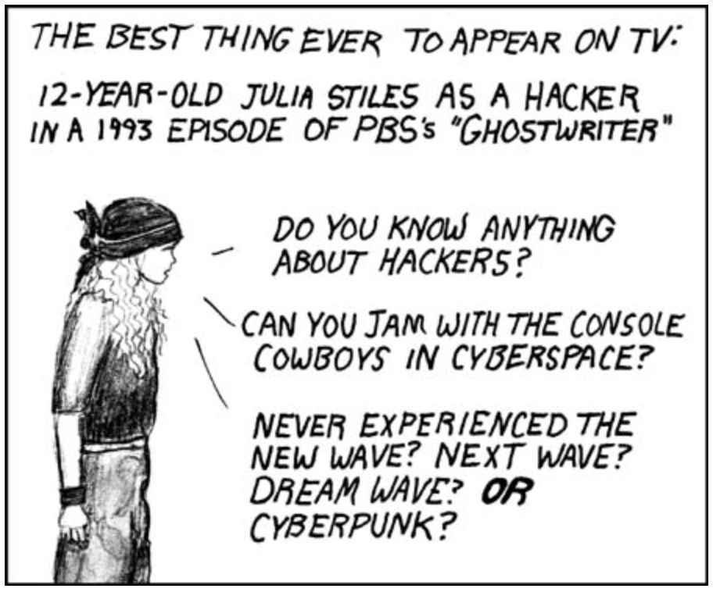
User Story
AS A/AN* xkcd enthusiast
I WANT my comics with my calendar
SO THAT I have more time for things in my calendar
*this presentation is timed, so let’s save the indefinite article/acronym debate for another time, grammar geeks

Slide 4

Design Process

Slide 5
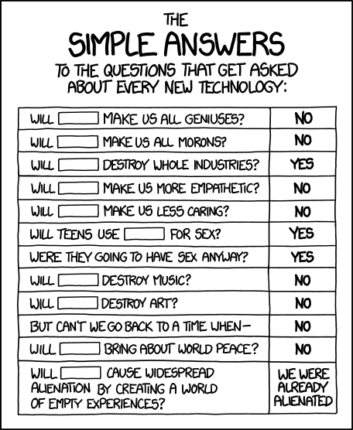
We have the technology…
Node and Express server
MySQL and Sequelize
Heroku
Datepicker
JAWS

Slide 6
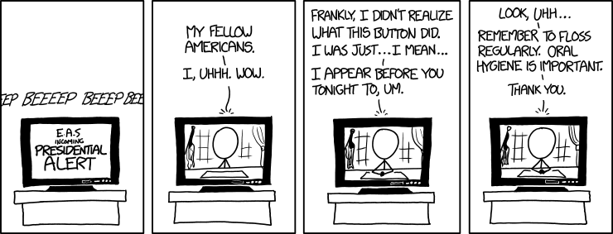
Now, brought to you live… Our Demo

Slide 7
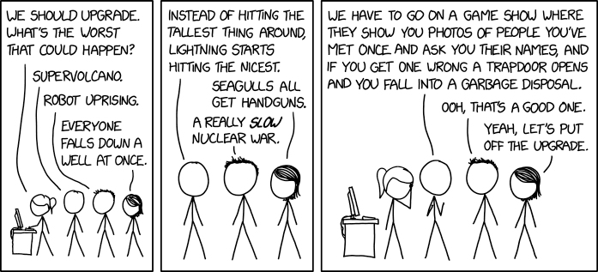
Plans for future upgrades
Get/save multiple comics for each date
Find comics by release date
Add user’s name
Update events

